Slide 1
Linear Programming 1
Dr Sam O’Neill

Slide 2
Contents
Introductory Example
Linear Programming Definition
Optimality on vertex
Python Solution using linprog
Simplex Method – Graphical Illustration (Depending on time)

Slide 3
Introductory Example
A firm manufactures two products (only) at their Beeham factory. Both products require the use of the GG74 machine.
Product X requires 3 hours per unit at this machine
Product Y requires 2 hours per unit at this machine
In any week there are 144 hours of time available
Each unit of Product X gives a Contribution to Profit of £5, and
Each unit of Product Y gives a Contribution to Profit of £7.

Slide 4
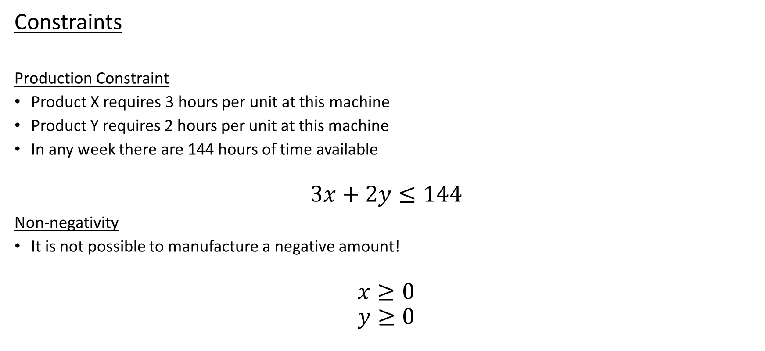
Linear Programming Model
Constraints
Production Constraint
Product X requires 3 hours per unit at this machine
Product Y requires 2 hours per unit at this machine
In any week there are 144 hours of time available
$$3x+2y≤144$$
Non-negativity
It is not possible to manufacture a negative amount!
$$x≥0 \\ y≥0$$

Slide 5
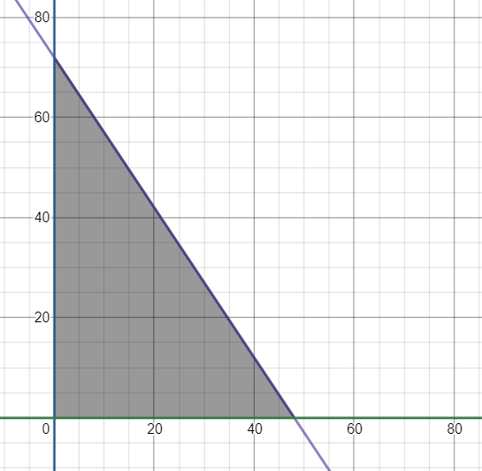
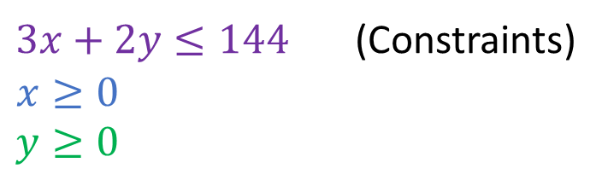
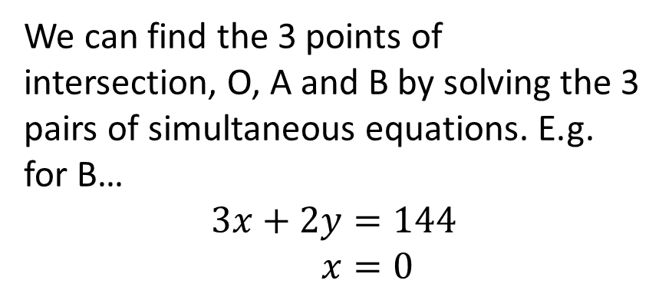
Linear Programming Model
Feasible Region
Any point within the feasible region is a solution to the system of inequalities.
B
$3x+2y≤144$ (Constraints)
$$x≥0 \\ y≥0$$
We can find the 3 points of intersection, O, A and B by solving the 3 pairs of simultaneous equations. E.g. for B…
$$3x+2y=144 \\ x=0$$
A
O

Slide 6
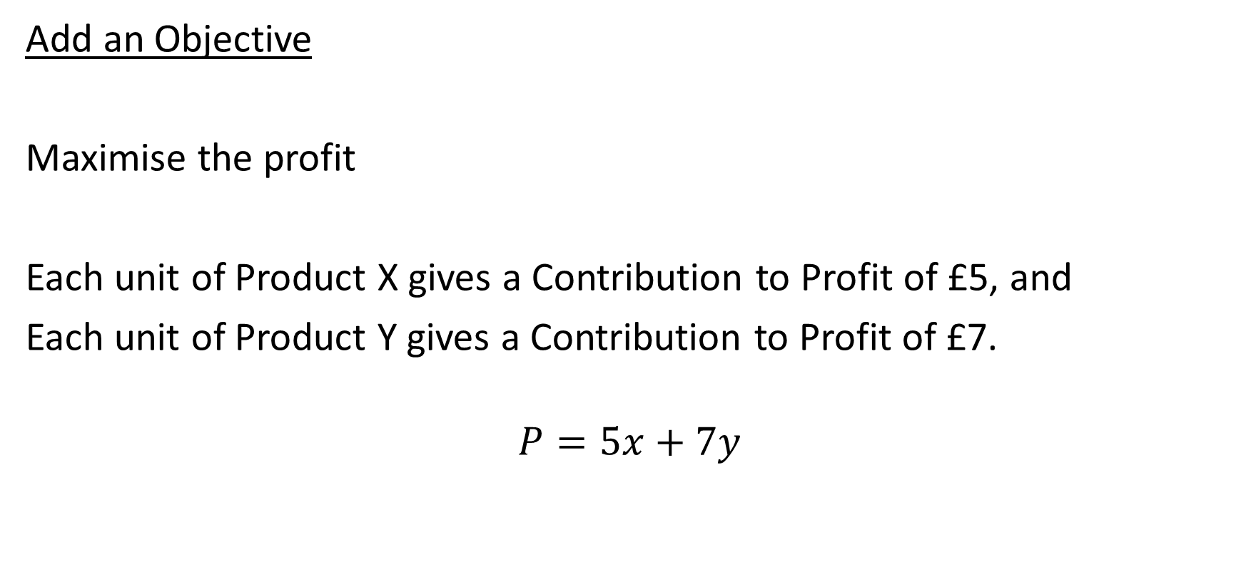
Linear Programming Model
Add an Objective
Maximise the profit
Each unit of Product X gives a Contribution to Profit of £5, and
Each unit of Product Y gives a Contribution to Profit of £7.
$$P=5x+7y$$

Slide 7
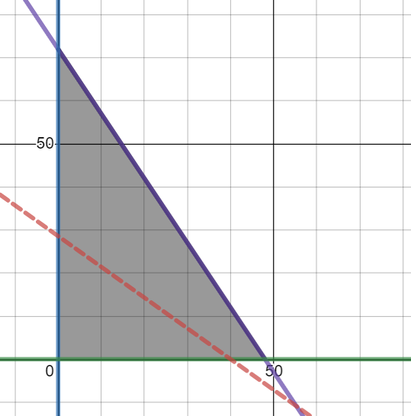
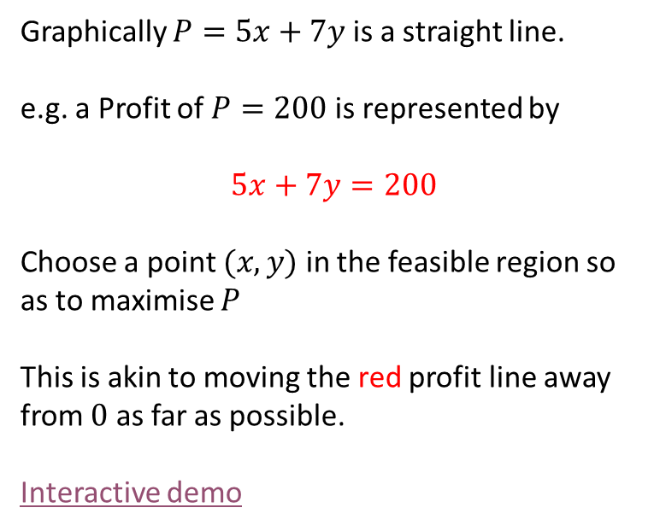


Linear Programming Model
Graphically $P=5x+7y$ is a straight line.
e.g. a Profit of $P=200$ is represented by
$$5x+7y=200$$
Choose a point $(x,y)$ in the feasible region so as to maximise $P$
This is akin to moving the red profit line away from $0$ as far as possible.
Interactive demo
$$3x+2y≤144$$
$$P=5x+7y$$

Slide 8
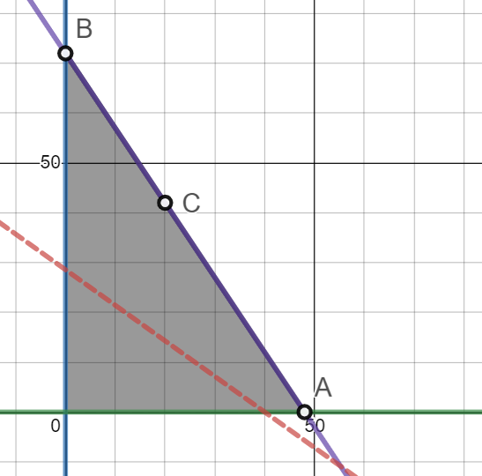
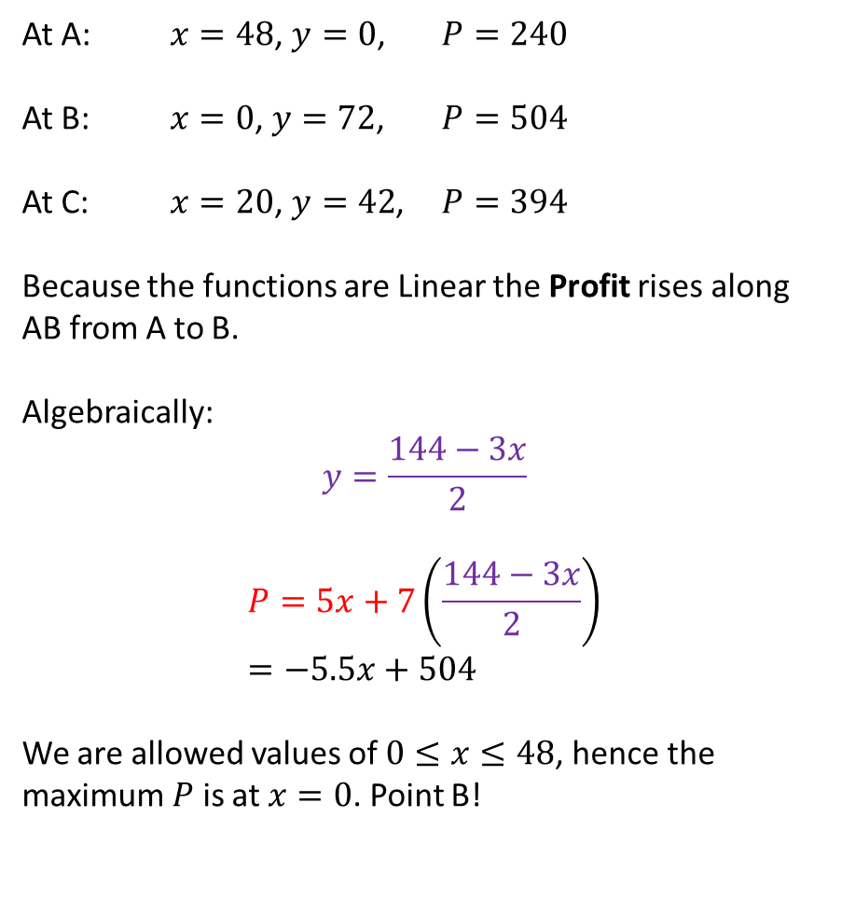
Linear Programming Model
At A: $x=48$, $y=0$, $P=240$
At B: $x=0$, $y=72$, $P=504$
At C: $x=20$, $y=42$, $P=394$
Because the functions are Linear the Profit rises along AB from A to B.
Algebraically:
$$y=\frac{144−3x}{2}$$
$$P=5x+7\left(\frac{144−3x}{2}\right) \\ =−5.5x+504$$
We are allowed values of $0≤x≤48$, hence the maximum $P$ is at $x=0$. Point B!
$$3x+2y≤144$$
$$P=5x+7y$$

Slide 9
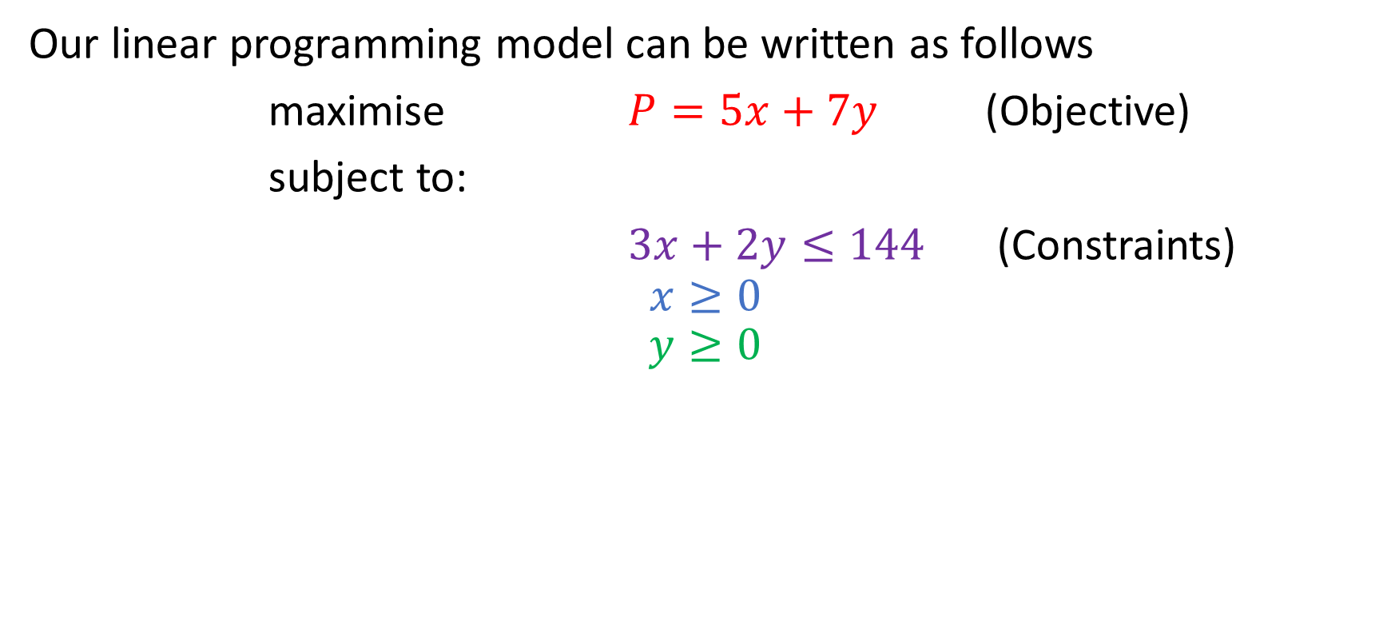
Linear Programming Model
Our linear programming model can be written as follows
maximise $P=5x+7y$ (Objective)
subject to:
$3x+2y≤144$ (Constraints)
$$x≥0 \\ y≥0$$

Slide 10
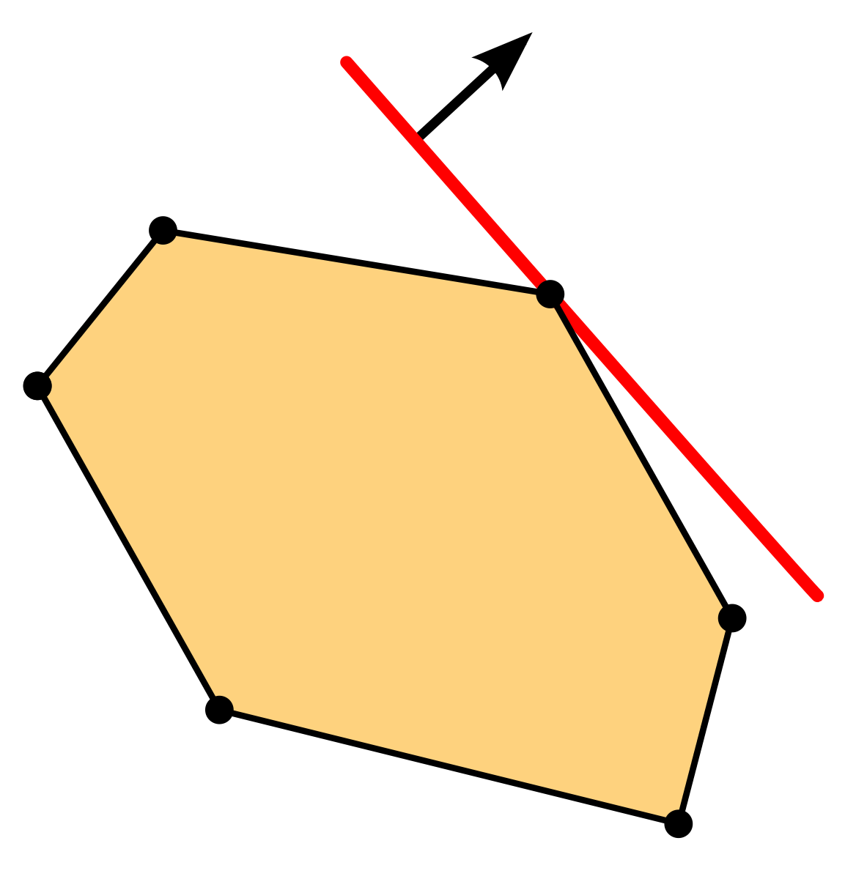
Observations
We had 1 constraint and 2 variables.
  The optimal solution had one variable set to 0…
The solution was at a vertex (corner of the feasible region)
Intuitively we are moving the objective function (linear equation) over the feasible region until we exit.

Slide 11
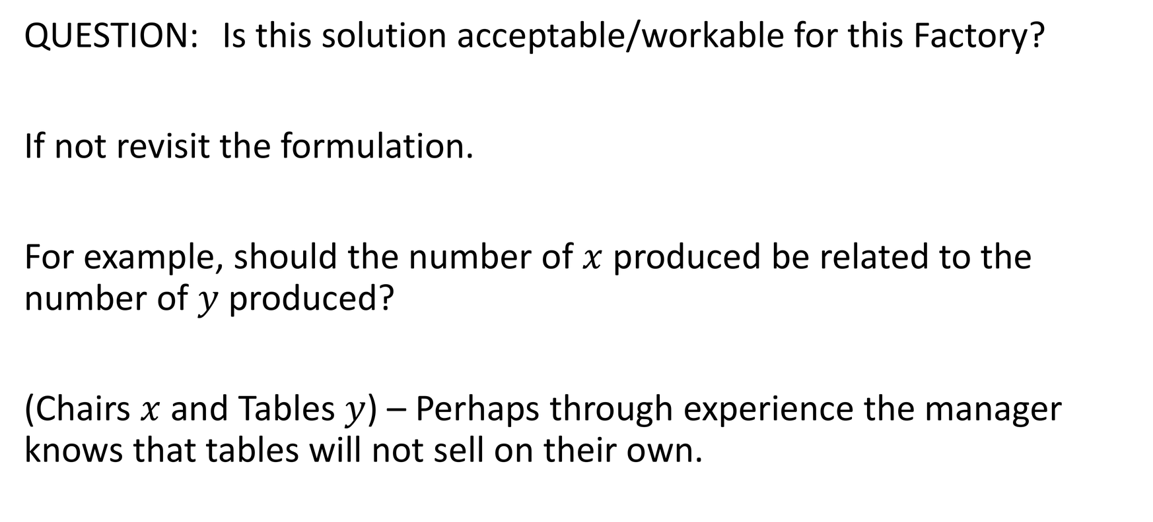
Is it a suitable solution?
QUESTION: Is this solution acceptable/workable for this Factory?
If not revisit the formulation.
For example, should the number of $x$ produced be related to the number of $y$ produced?
(Chairs $x$ and Tables $y$) – Perhaps through experience the manager knows that tables will not sell on their own.

Slide 12
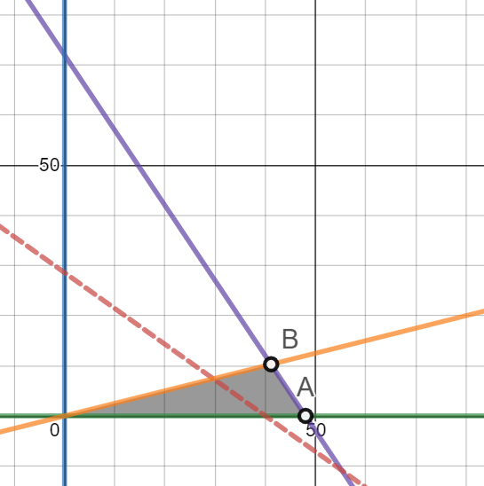
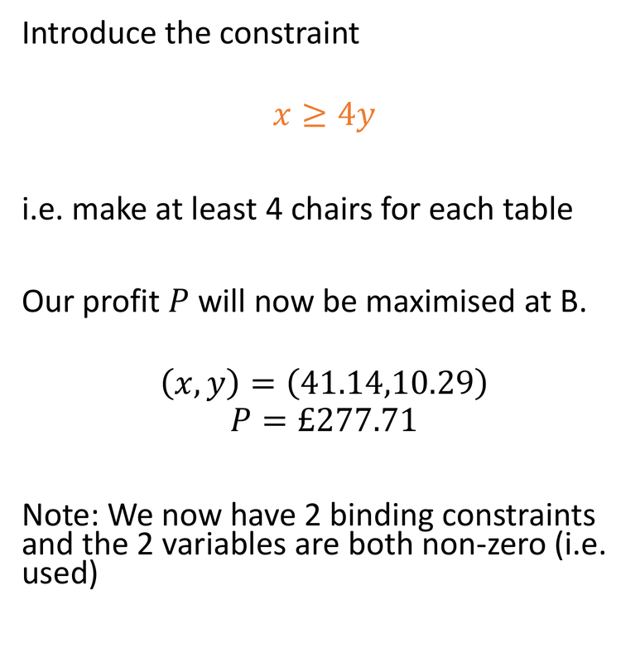


Is it a suitable solution?
Introduce the constraint
$$x≥4y$$
i.e. make at least 4 chairs for each table
Our profit $P$ will now be maximised at B.
$$\left(x,y\right)=\left(41.14,10.29\right)$$
$$P=£277.71$$
Note: We now have 2 binding constraints and the 2 variables are both non-zero (i.e. used)
$$3x+2y≤144$$
$$x≥4y$$

Slide 13
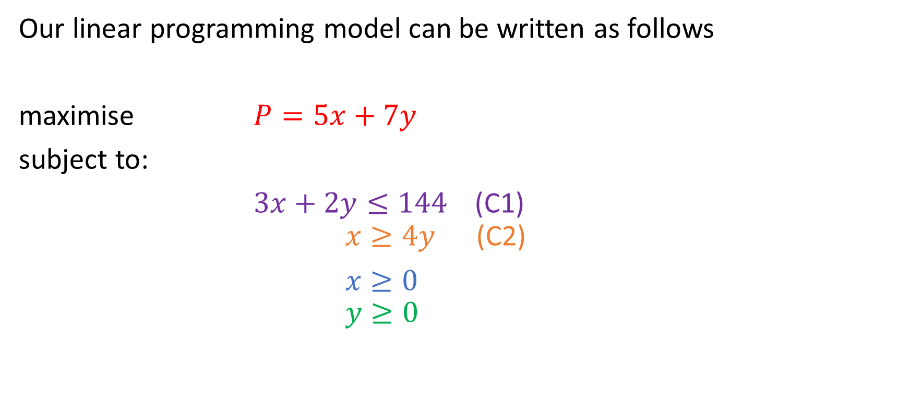


Linear Programming Model
Our linear programming model can be written as follows
maximise $P=5x+7y$
subject to:
$3x+2y≤144$ (C1)
$x≥4y$ (C2)
$x≥0$
$y≥0$
$$3x+2y≤144$$
$$x≥4y$$

Slide 14
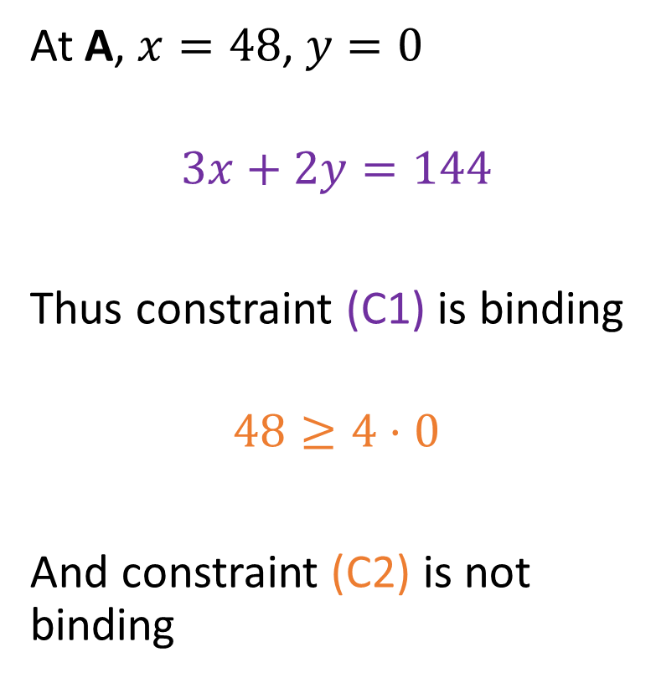
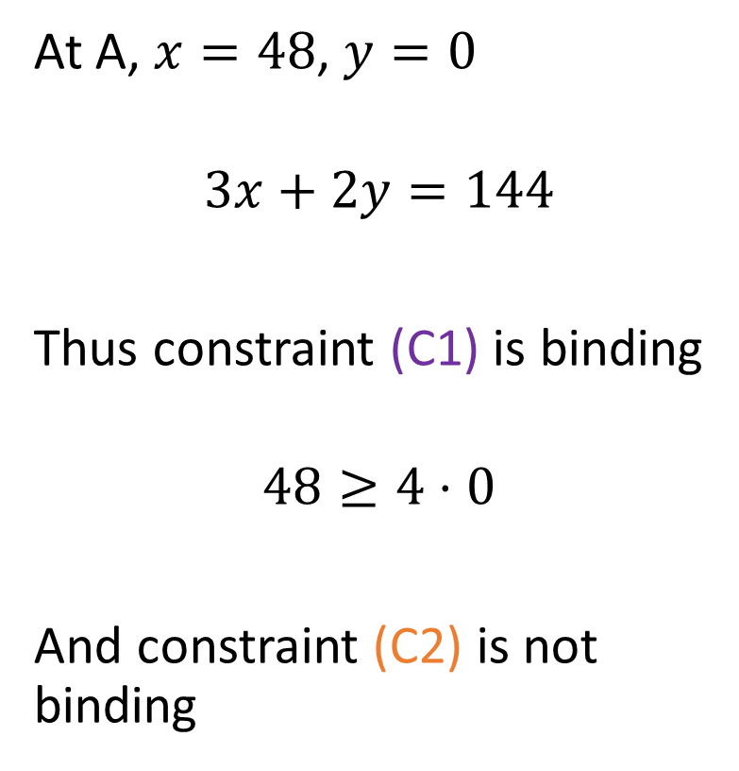
Binding Constraints
At A, $x=48$, $y=0$
$$3x+2y=144$$
Thus constraint (C1) is binding
$$48≥4⋅0$$
And constraint (C2) is not binding
$$3x+2y≤144$$
$$x≥4y$$

Slide 15
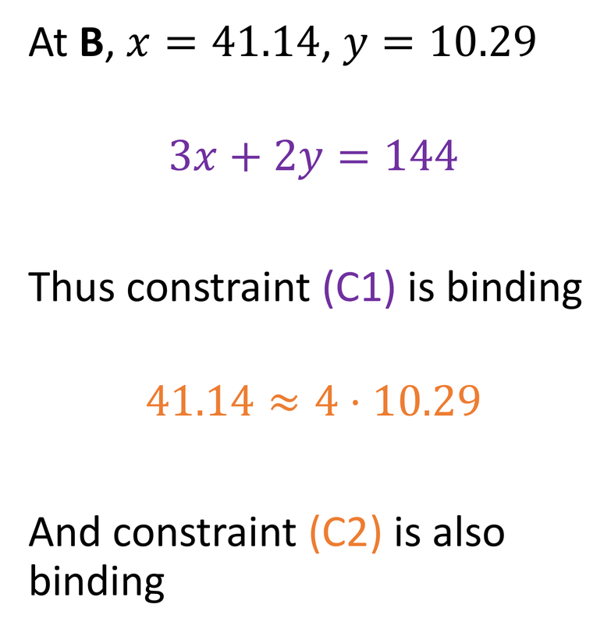
Binding Constraints
At B, $x=41.14$, $y=10.29$
$$3x+2y=144$$
Thus constraint (C1) is binding
$$41.14≈4⋅10.29$$
And constraint (C2) is also binding
$$3x+2y≤144$$
$$x≥4y$$

Slide 16
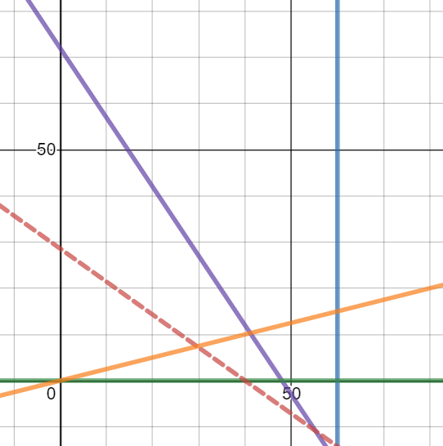
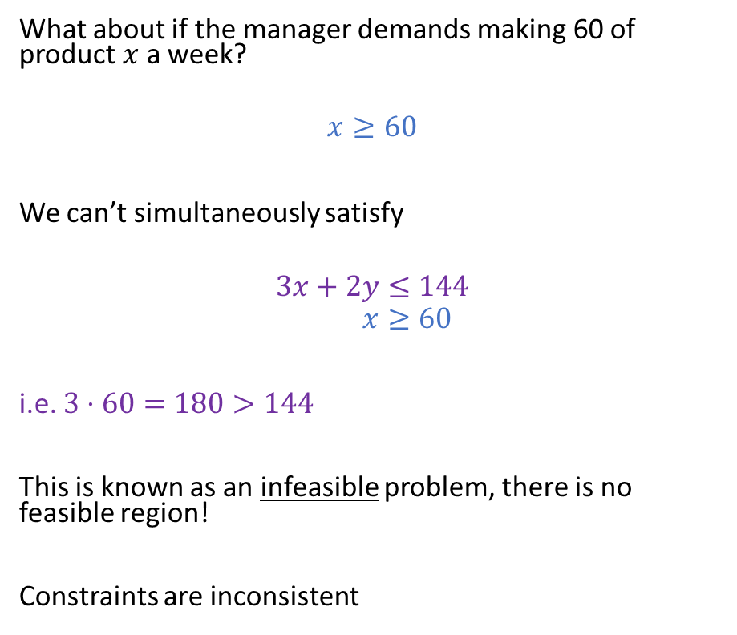
Infeasible
What about if the manager demands making 60 of product $x$ a week?
$$x≥60$$
We can’t simultaneously satisfy
$$3x+2y≤144 \\ x≥60$$
i.e. $3⋅60=180>144$
This is known as an infeasible problem, there is no feasible region!
Constraints are inconsistent

Slide 17
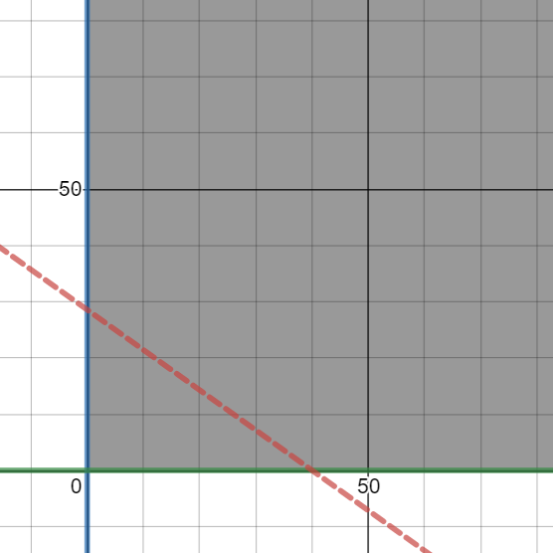
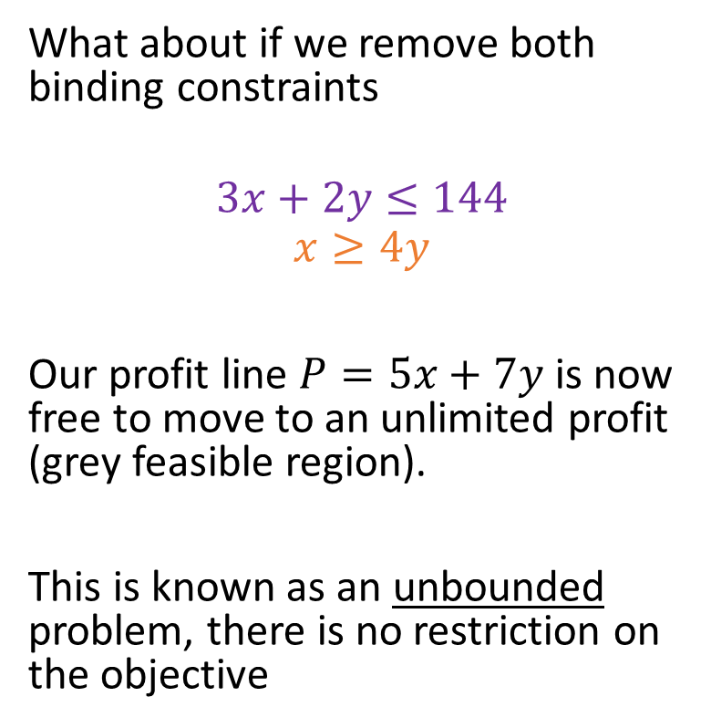
Unbounded
What about if we remove both binding constraints
$$3x+2y≤144$$
$$x≥4y$$
Our profit line $P=5x+7y$ is now free to move to an unlimited profit (grey feasible region).
This is known as an unbounded problem, there is no restriction on the objective

Slide 18
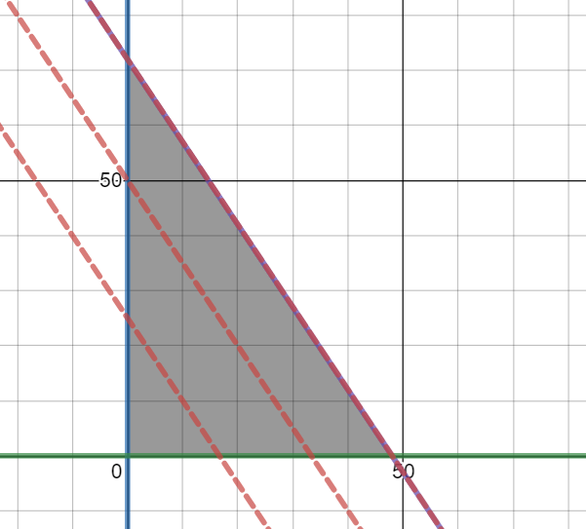
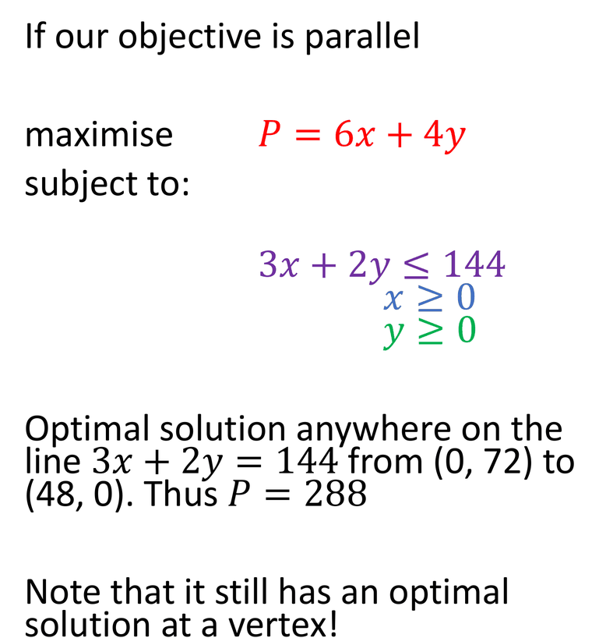



Infinite Solutions
If our objective is parallel
maximise $P=6x+4y$
subject to:
$3x+2y≤144$
$x≥0$
$y≥0$
Optimal solution anywhere on the line $3x+2y=144$ from (0, 72) to (48, 0). Thus $P=288$
Note that it still has an optimal solution at a vertex!
$$6x+4y=288$$
$$6x+4y=200$$
$$6x+4y=100$$

Slide 19
Optimality
An optimal solution always lies on the boundary of the feasible region: at a vertex, or along a whole edge (infinitely many solutions).
If an optimal solution exists, one is always at a vertex. The vertices are known as Basic Feasible Solutions.
A Basic Feasible Solution (BFS) is the intersection of a number of boundaries.

Slide 20
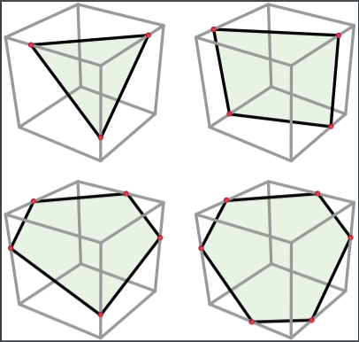
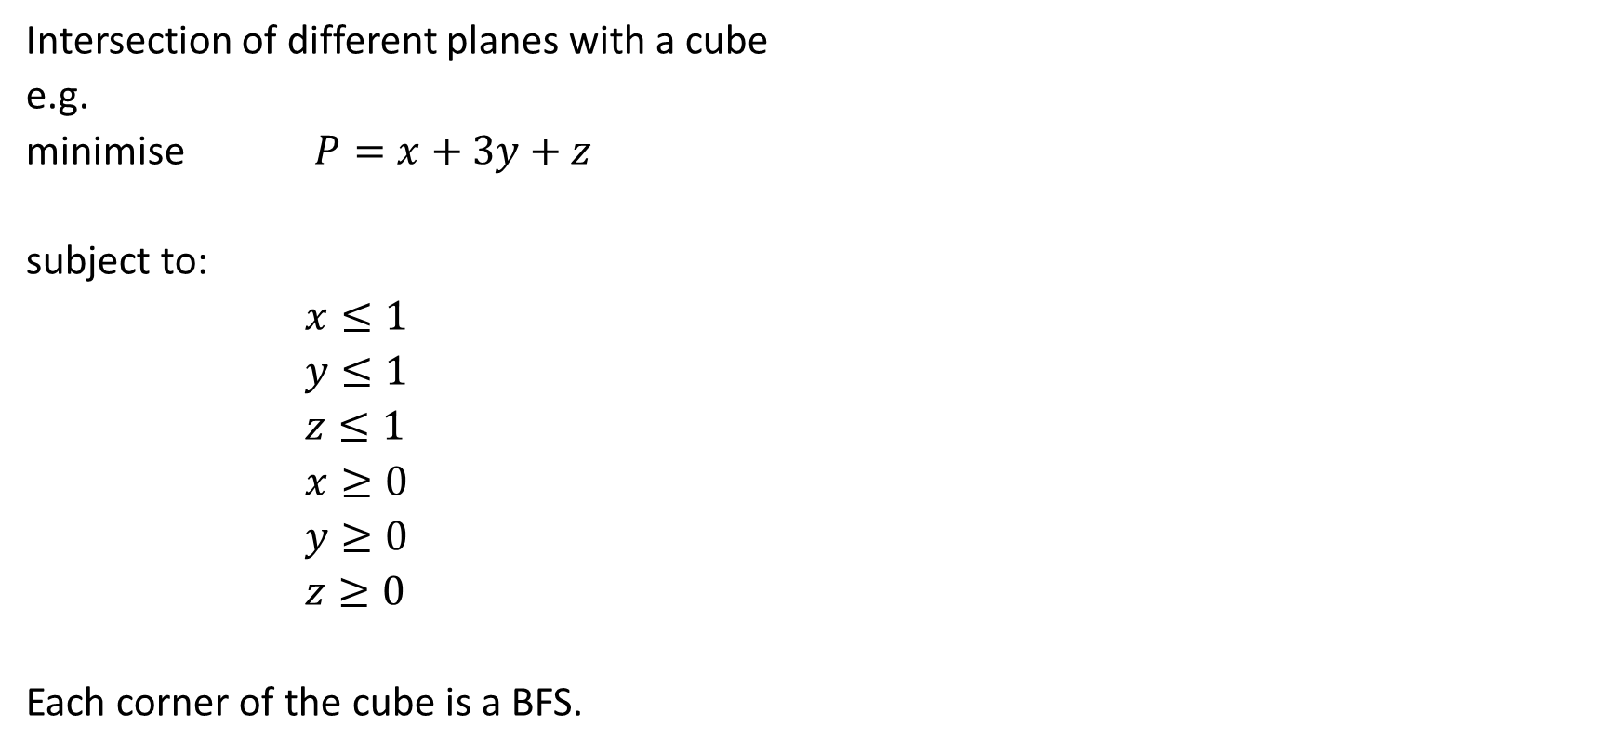
Graphical illustration of 3 variables
Intersection of different planes with a cube
e.g.
minimise $P=x+3y+z$
subject to:
$x≤1$
$y≤1$
$z≤1$
$x≥0$
$y≥0$
$z≥0$
Each corner of the cube is a BFS.

Slide 21
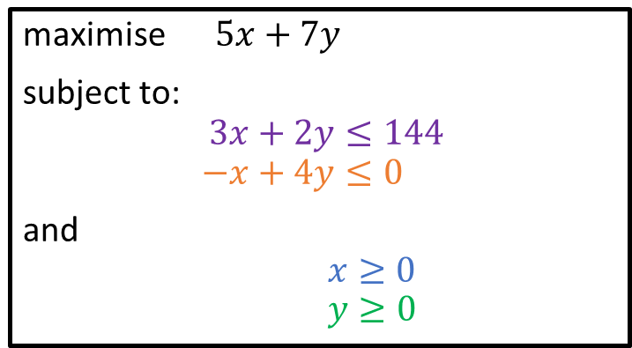
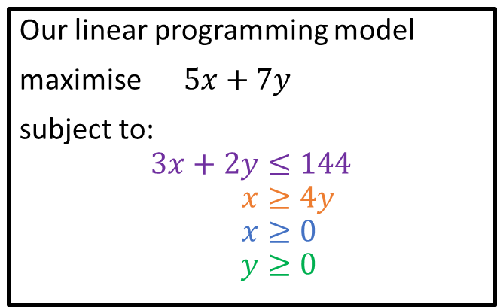
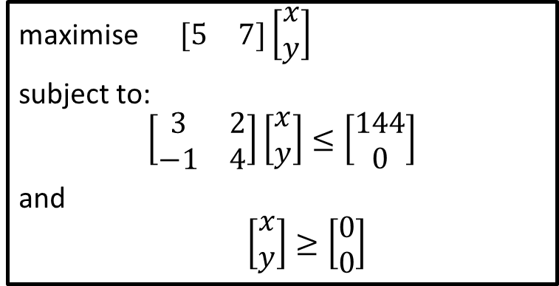
Canonical Form (Matrices)
Our linear programming model
maximise $5x+7y$
subject to:
$$3x+2y≤144 \\ x≥4y \\ x≥0 \\ y≥0$$
maximise $5x+7y$
subject to:
$$3x+2y≤144 \\ −x+4y≤0$$
and
$x≥0$
$y≥0$
maximise $\begin{matrix}[5 & 7]\left[\begin{matrix}x \\ y\end{matrix}\right]\end{matrix}$
subject to:
$$\left[\begin{matrix}3 & 2 \\ −1 & 4\end{matrix}\right]\left[\begin{matrix}x \\ y\end{matrix}\right]≤\left[\begin{matrix}144 \\ 0\end{matrix}\right]$$
and
$\left[\begin{matrix}x \\ y\end{matrix}\right]≥\left[\begin{matrix}0 \\ 0\end{matrix}\right]$

Slide 22
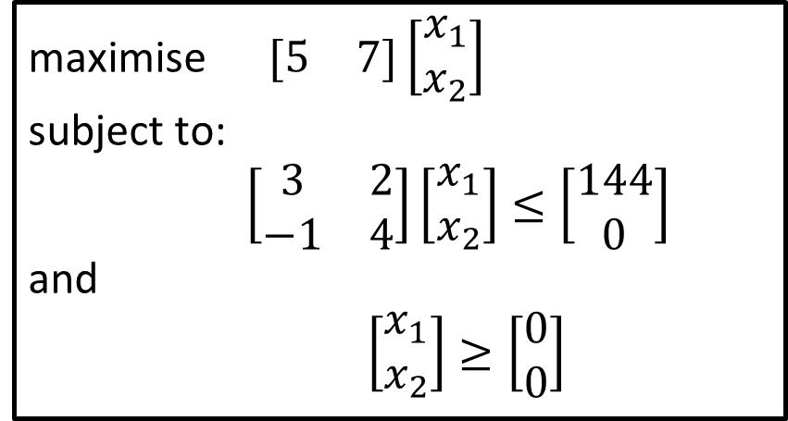
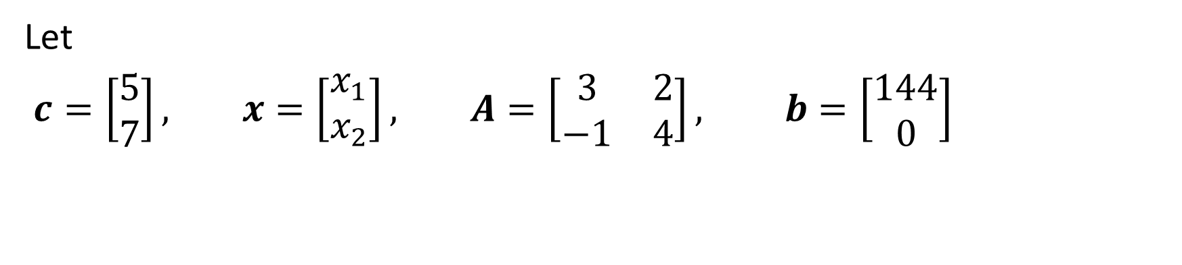
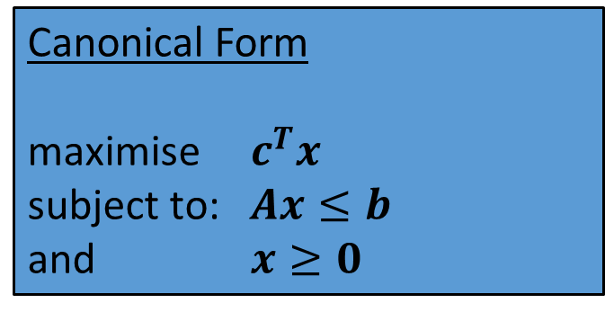
Canonical Form (Matrices)
Let
$c=\left[\begin{matrix}5 \\ 7\end{matrix}\right], x=\left[\begin{matrix}x_{1} \\ x_{2}\end{matrix}\right], A=\left[\begin{matrix}3 & 2 \\ −1 & 4\end{matrix}\right], b=\left[\begin{matrix}144 \\ 0\end{matrix}\right]$
maximise $\begin{matrix}[5 & 7]\left[\begin{matrix}x_{1} \\ x_{2}\end{matrix}\right]\end{matrix}$
subject to:
$\left[\begin{matrix}3 & 2 \\ −1 & 4\end{matrix}\right]\left[\begin{matrix}x_{1} \\ x_{2}\end{matrix}\right]≤\left[\begin{matrix}144 \\ 0\end{matrix}\right]$
and
$\left[\begin{matrix}x_{1} \\ x_{2}\end{matrix}\right]≥\left[\begin{matrix}0 \\ 0\end{matrix}\right]$
Canonical Form
maximise $c^{T}x$
subject to: $Ax≤b$
and $x≥0$

Slide 23

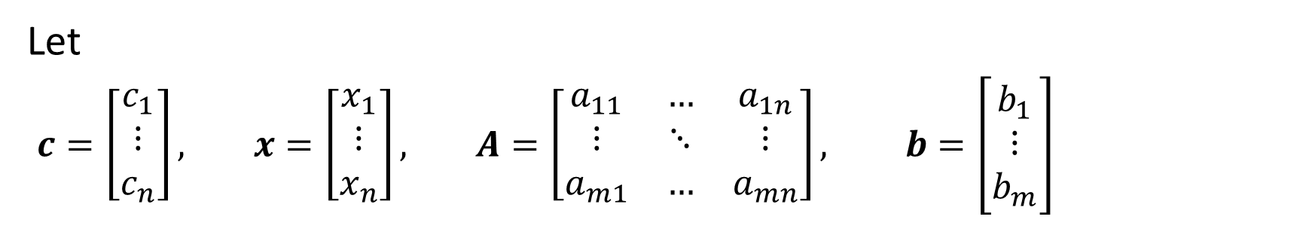

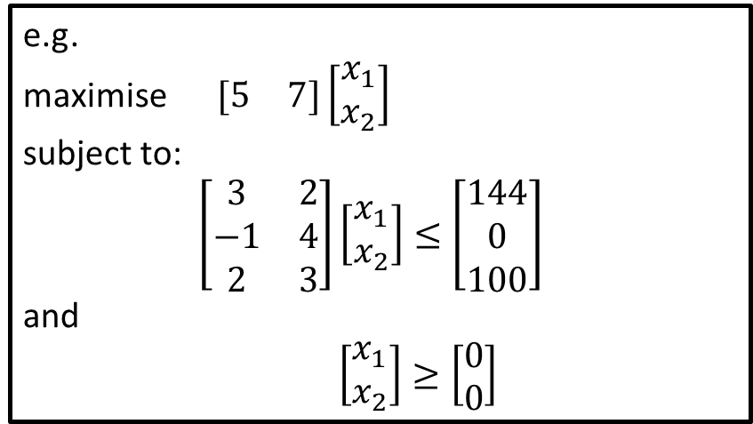
In general
Let
$c=\left[\begin{matrix}c_{1} \\ \begin{aligned}⋮ \\ c_{n}\end{aligned}\end{matrix}\right], x=\left[\begin{matrix}x_{1} \\ \begin{aligned}⋮ \\ x_{n}\end{aligned}\end{matrix}\right], A=\left[\begin{matrix}a_{11} & … & a_{1n} \\ ⋮ & ⋱ & ⋮ \\ a_{m1} & … & a_{mn}\end{matrix}\right], b=\left[\begin{matrix}b_{1} \\ \begin{aligned}⋮ \\ b_{m}\end{aligned}\end{matrix}\right]$
e.g.
maximise $\begin{matrix}[5 & 7]\left[\begin{matrix}x_{1} \\ x_{2}\end{matrix}\right]\end{matrix}$
subject to:
$\left[\begin{matrix}3 & 2 \\ −1 & 4 \\ 2 & 3\end{matrix}\right]\left[\begin{matrix}x_{1} \\ x_{2}\end{matrix}\right]≤\left[\begin{matrix}144 \\ 0 \\ 100\end{matrix}\right]$
and
$\left[\begin{matrix}x_{1} \\ x_{2}\end{matrix}\right]≥\left[\begin{matrix}0 \\ 0\end{matrix}\right]$
Canonical Form
maximise $c^{T}x$
subject to: $Ax≤b$
and $x≥0$
What are $m$ and $n$ for the example?

Slide 24
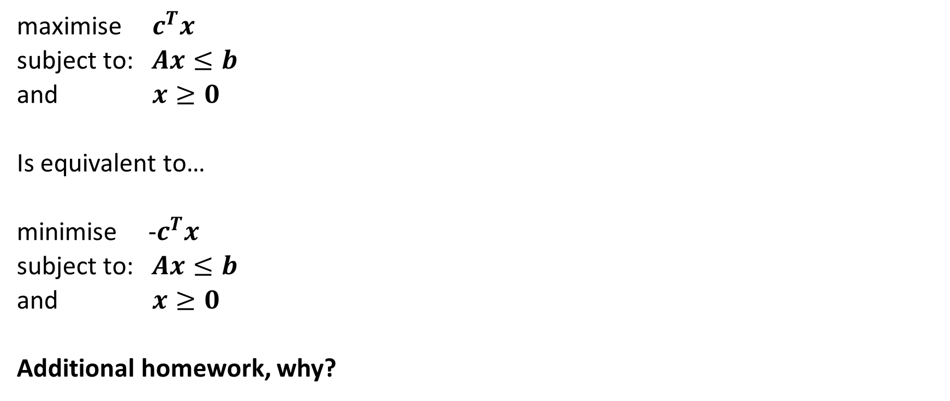
Maximum and minimum equivalence
maximise $c^{T}x$
subject to: $Ax≤b$
and $x≥0$
Is equivalent to…
minimise -$c^{T}x$
subject to: $Ax≤b$
and $x≥0$
Additional homework, why?

Slide 25
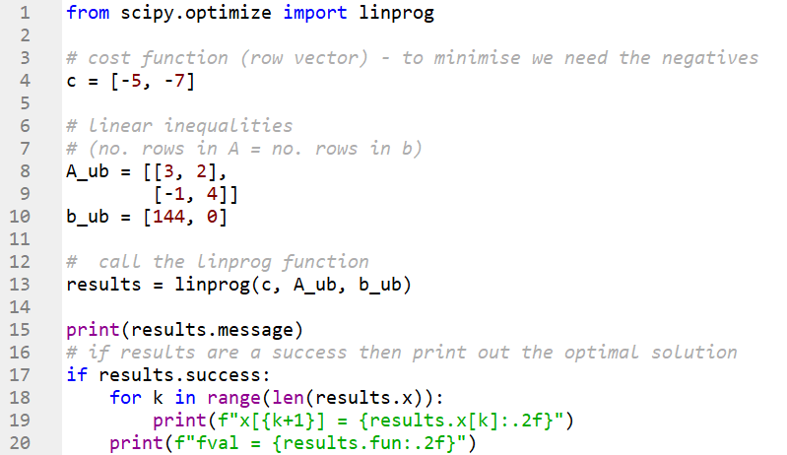
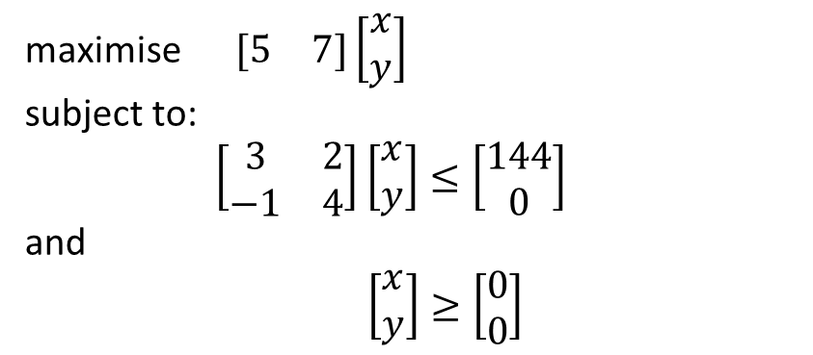
Solution via Python
maximise $\begin{matrix}[5 & 7]\left[\begin{matrix}x \\ y\end{matrix}\right]\end{matrix}$
subject to:
$\left[\begin{matrix}3 & 2 \\ −1 & 4\end{matrix}\right]\left[\begin{matrix}x \\ y\end{matrix}\right]≤\left[\begin{matrix}144 \\ 0\end{matrix}\right]$
and
$\left[\begin{matrix}x \\ y\end{matrix}\right]≥\left[\begin{matrix}0 \\ 0\end{matrix}\right]$
We are maximising.
The Python function linprog minimises!
Notice that in the Python code we set c = [-5, -7]
scipy.optimize.linprog — SciPy documentation

Slide 26
Solution via Python
We will use a friendlier way to express this next week, however it is important to:
get to understand the canonical form
think about this in terms of Linear Algebra

Slide 27
Tutorial
Solve a linear program with Python
Solve a linear program with Excel
Model a simple LP problem and solve
Model a more complicated LP, we will start the next lecture with a discussion about this.

